Slide 2
Agenda
Current Supervisor
Supervisor vision
Work to date
FNET review
Next steps
Key decisions

Slide 3
Agenda
Current Supervisor
Functional & Non-Functional Scope
Architecture / technologies
Solution options
Solution & approach
Work to date
Next steps
Key decisions

Slide 4
Current Supervisor
Application:
  VB6 thick client / monolith
  Multiple code sets
  Complex code
Key drivers:
  Technical refresh
  Speed of delivery
  Look and feel
  Supervisor is an important sales tool
  Business enhancements
Database:
  Outdated technology
  Mixture of embedded SQL / stored procedures presents security and tuning issues
  No robust concurrency mechanisms
  Schema divergence

Slide 5
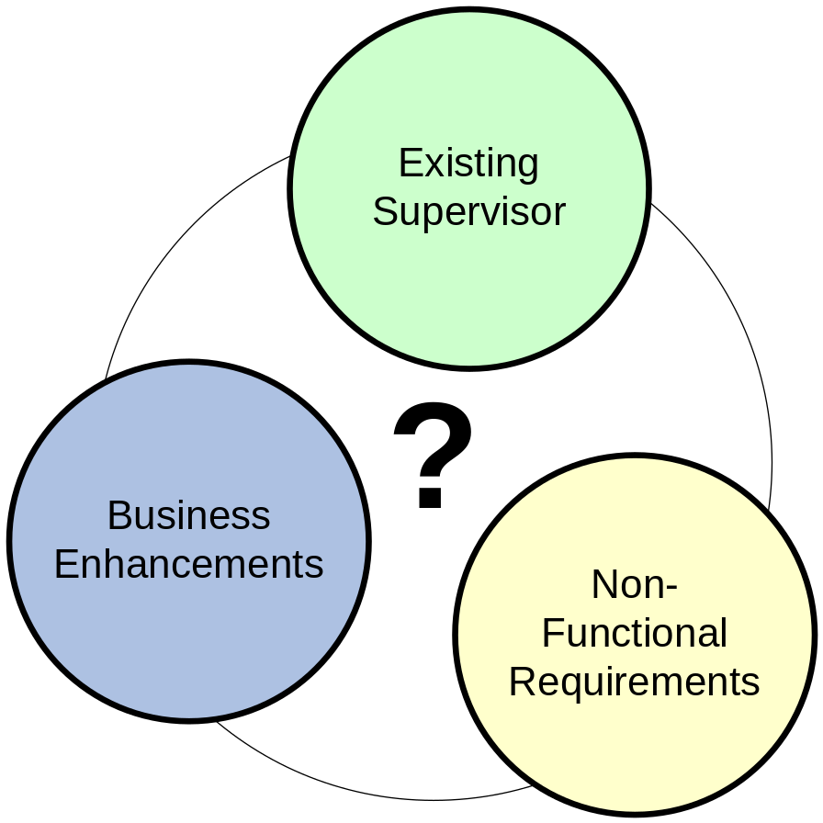
Functional & Non-Functional Scope
Subset of existing features
Business enhancements
  Approximately 64 enhancements identified
Additional NFR’s
Backwards compatibility
  Existing clients
  Database compatibility
  Constrains SOA
Define base functionality
  Equivalence to DB features
Supervisor is product

Slide 6
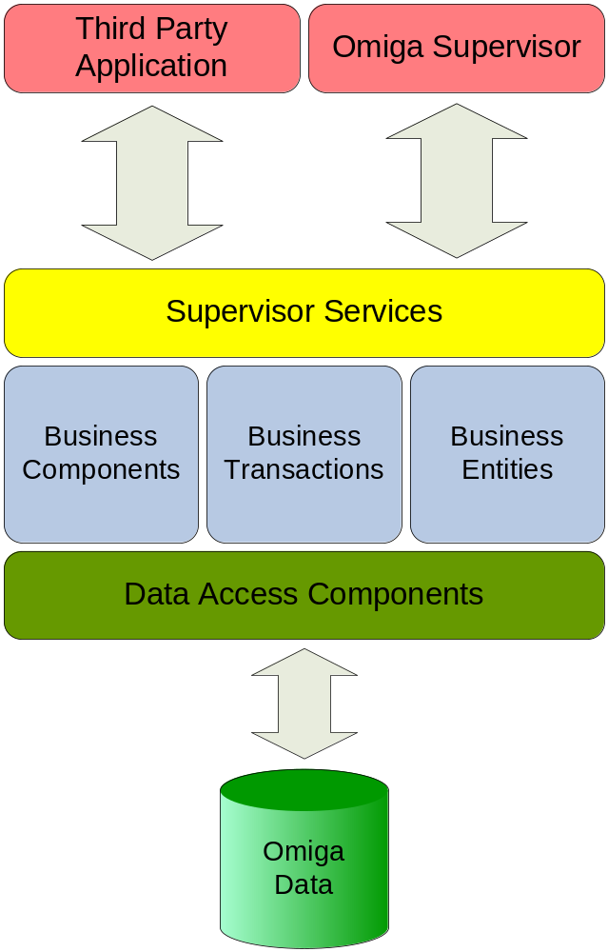
Supervisor Vision
Reuse
  Elements from 1ST
  Elements from Exchange
  Microsoft Patterns & Practices
  Open source
Buy
  Framework
  3rd party components
Build
  Application logic
Single database
for all services
Notes:
Designed for:
Service Oriented Architecture (SOA)
Pluggable / client bespoke
Modular code, loosely coupled
Up to date technologies:
.NET 3.0 / 3.5
Communication Foundation (WCF)
Workflow Foundation (WF)
Presentation Foundation (WPF)
SQL Server 2005 / 8
Rich Client experience:
Windows based user interface
No thin client user interface
Smart Client deployment
“Hands free” end user deployment
ClickOnce technology

Slide 7
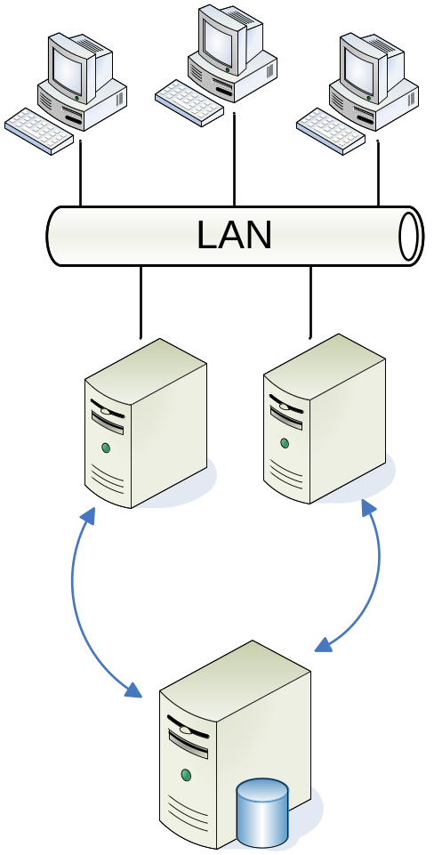
Solution Options
Smart Client options:
  Evaluate FNET
  Buy third party framework
  Build our own
Reusable Services:
  Distinct service layer built on .NET 3.0
  System of sub-systems
  Support for Supervisor client
  Support for third party client
Database
  Single database schema

Slide 8
Solution Priorities
Reuse
  Elements from 1ST
  Elements from Exchange
  Microsoft Patterns & Practices
  Open source
Buy
  Framework
  3rd party components
Build
  Application logic

Slide 9
Approach
Feature
Driven
Quality
Focussed
Iterative
Planning
Continuous
Testing

Slide 10
Approach:
Feature Driven
Feature
Driven
Plan iteration content by feature
Build services for features
Build complete functional slices
Separate development of services and consumer
Build services ahead of consumers

Slide 11
Approach:
Iterative
Iterative
Planning
No “big bang” delivery
Prioritise high risks
Aim for shorter, functionally complete deliveries
Reduced cycle time
  For development
  For testing functionality
  Reduced latency between code → testing

Slide 12
Approach:
Quality
Quality
Focussed
Test driven coding
  Tests defined by analysis
  Unit testing tools
  Targeted test coverage
Continuous integration
  Code defects immediately visible
  Measurable quality
Expect zero defects
Traceability
  No redundancy
  Adaptable to change
  Accurate impact assessment

Slide 13
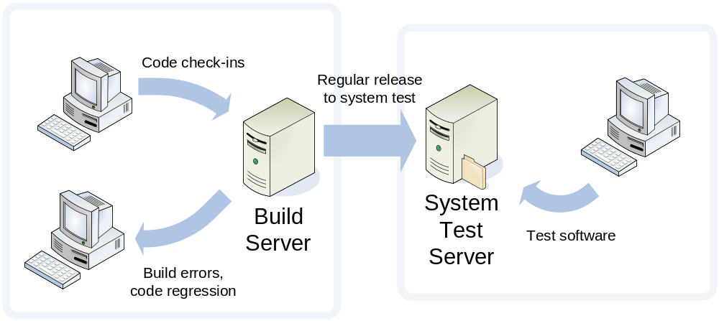
Approach:
Continuous Testing
Developer testing
Automated builds
Automated testing
Continuous
Testing
Continuous integration
Test collaboration

Slide 14
Work to Date
Preliminary scoping
Preliminary architecture
Evaluation of FNET framework
End to end proof of concept / prototype
  Thin vertical functional slice of Supervisor
  Rich Client and Thin Client
  Service Oriented
  .NET 3.0 WCF
Process definition

Slide 15
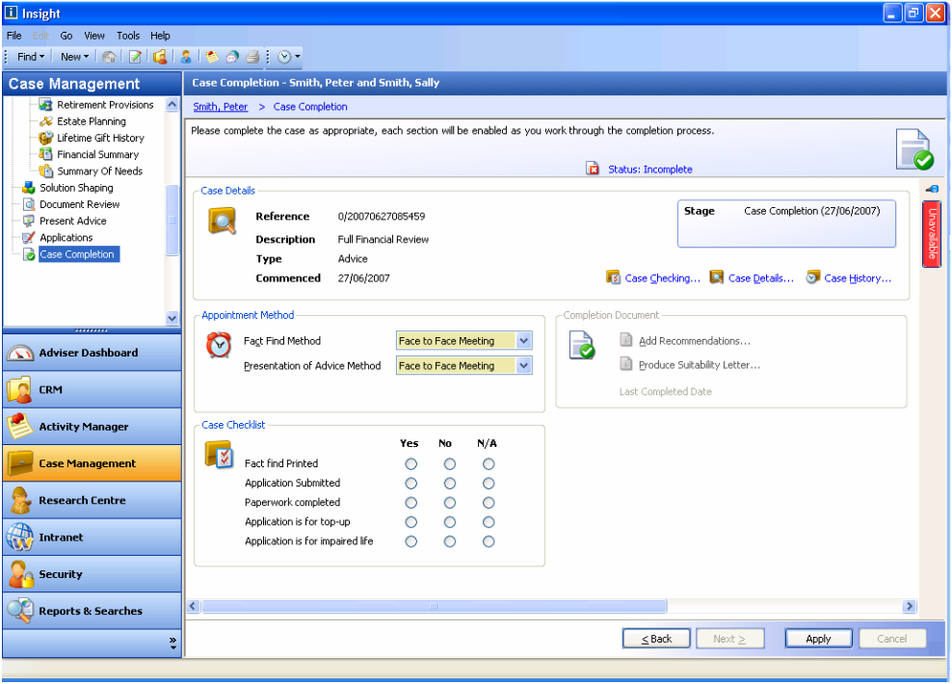
Work done:
FNET Framework
Generic rich client application
framework
Developed by 1ST Software
Used by:
  Mortgage Advise
  Adviser Evolution (AE)
  Adviser Evolution
  Mortgage Edition (AEME)
Advanced offline data
synchronisation
Advanced Smart Client
deployment
Built using C# / .NET 2.0
Attractive user interface
Sample UI screenshot from FNET project

Slide 16
Work done:
Summary of FNET Gaps
Gap | Suitability “as is” | 1ST Estimate | Impact
Smart Client deployment | Low | Medium | Medium
Function as an SOA client | Low | Large | High
Authentication | Low | Large | High
Authorisation | Medium | Medium | High
Documentation | Medium | Ongoing | High
Unit test coverage | Low | Ongoing | Medium
Concurrency / Locking | Low | Medium | High
Backwards compatibility | Low | Small | High
Indicative estimate from 1ST:
30 days → 276 days (92 man days +/- 300%)
Covers coding and unit testing
Additional analysis / design activity required
Does not include business enhancements

Slide 17
Work done:
.NET 3.0 Vertical Slice
TODO

Slide 18
Next Steps
Gap analysis between Supervisor variants
Define base functionality / requirements
Scope and prioritise functionality
Define detailed architecture
Produce high level estimates
Produce high level iteration plan
Define development process & tools
Define team shape and size
Identify training requirements
Create development and test environments

Slide 19
Key Decisions
Do we use the FNET framework?
Is Supervisor product?
Confirm scope including business enhancements
Do we build a rich client user interface or combination of rich and thin client?
Identify required level of backward compatibility

